Slide 1
Digital Media Technology Week 8: Introduction to XSLT

Slide 2
Digital Humanities
It brings computational techniques to bear on traditional humanistic questions
It studies the phenomenon of computation from a humanities perspective, and aims to understand the epistemological and the methodological implications of using computers in humanities research

Slide 3

Expertise
Four components:
Domain knowledge
Skills
Competencies
Mindset
Vivian Lewis et al. , Building Expertise to Support Digital Scholarship: A Global Perspective. CLIR, 2015.

Slide 4
Definitions of data
”factual records ... used as primary sources for scientific research, and that are commonly accepted in the scientific community as necessary to validate research findings” (OECD report on Principles and Guidelines for Access to Research Data from Public)
Facts refer to phenomena or events which “pertain to objective reality”. Data “represent real world facts” (Dervos & Coleman, "A Common Sense Approach to Defining Data, Information, and Metadata")

Slide 5
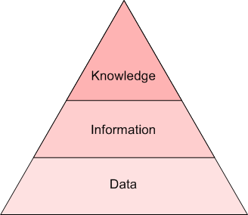
Interpretation continuum
R. L. Ackoff, "From Data to Wisdom", in: Journal of Applied Systems Analysis, 16 (1989), pp. 3–9.

Slide 6
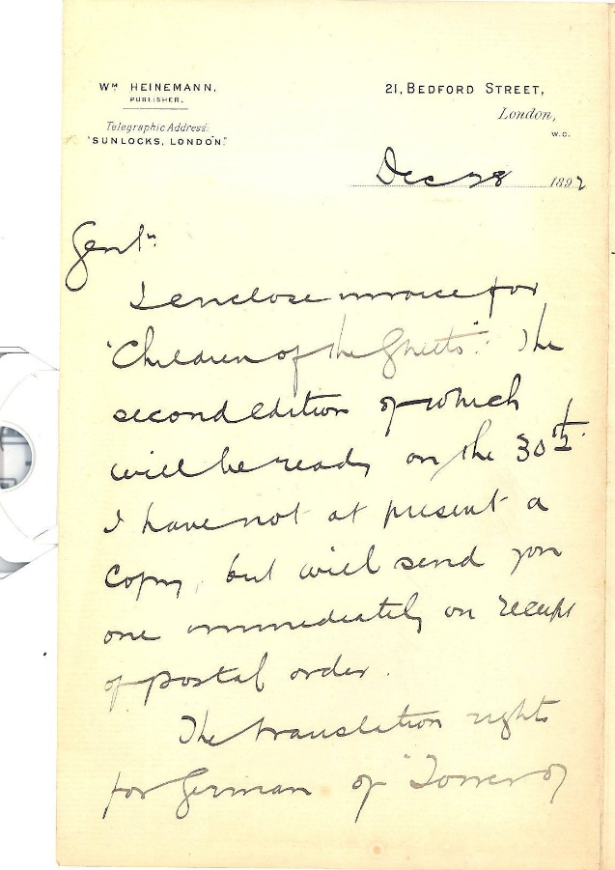
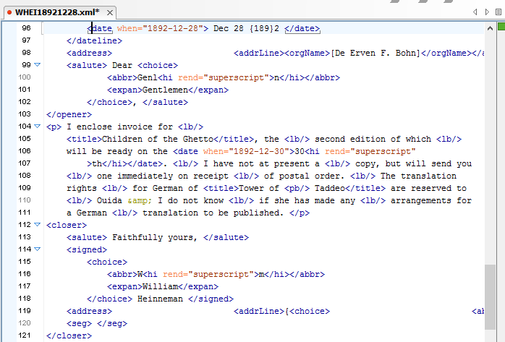

Slide 7
Captured data: raw data generated “through some form of measurement such as observation, surveys, lab and field experiments, record keeping […], cameras, scanners and sensors”.
Derived data: “produced through additional processing or analysis of captured data”.
Rob Kitchin, The Data Revolution, 2014

Slide 8
Information
“Captured data”: Discrete data values
“Derived data”:
Statistical resources
Sources
Algorithms

Slide 9
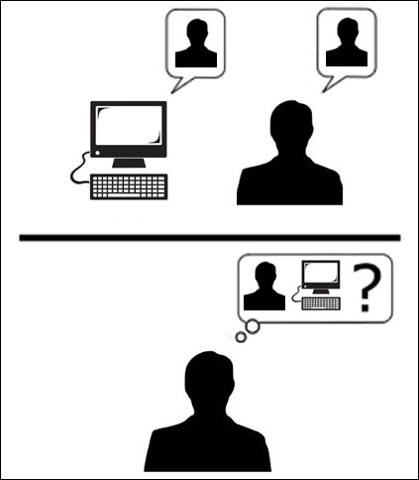
Artificial Intelligence
Alan Turing, “Computing Machinery and Intelligence”
Turing test
The Universal Machine
Computer can perform any activity which can be caught in an algorithm (state of being “Turing-complete”)

Slide 10
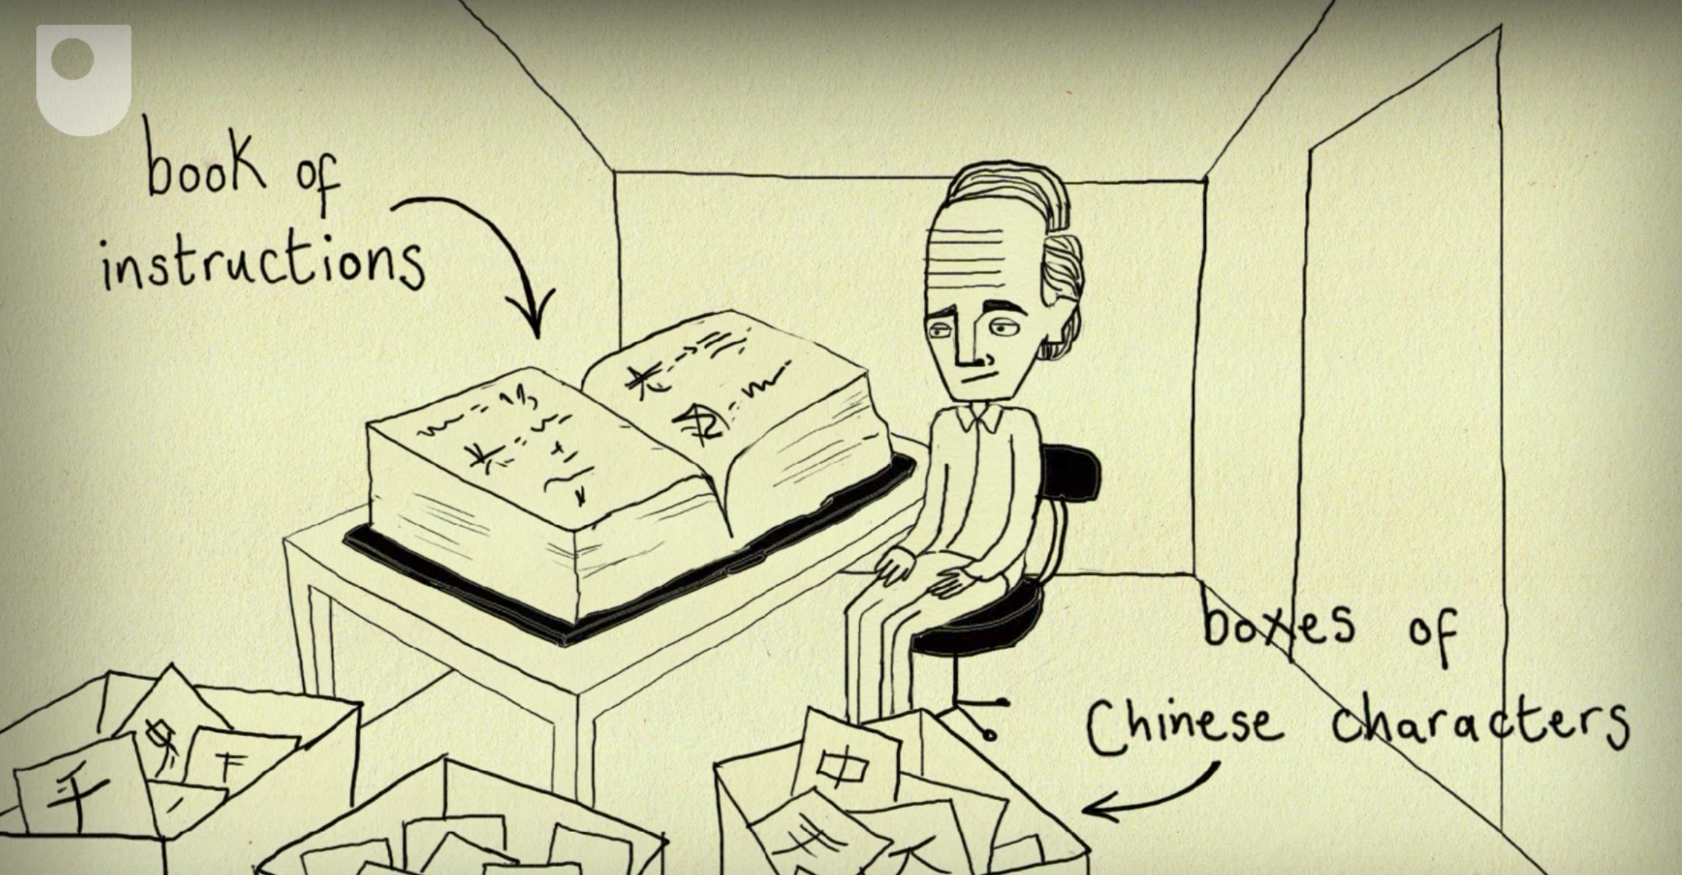
John Searle’s “Chinese Room Argument”

Slide 11
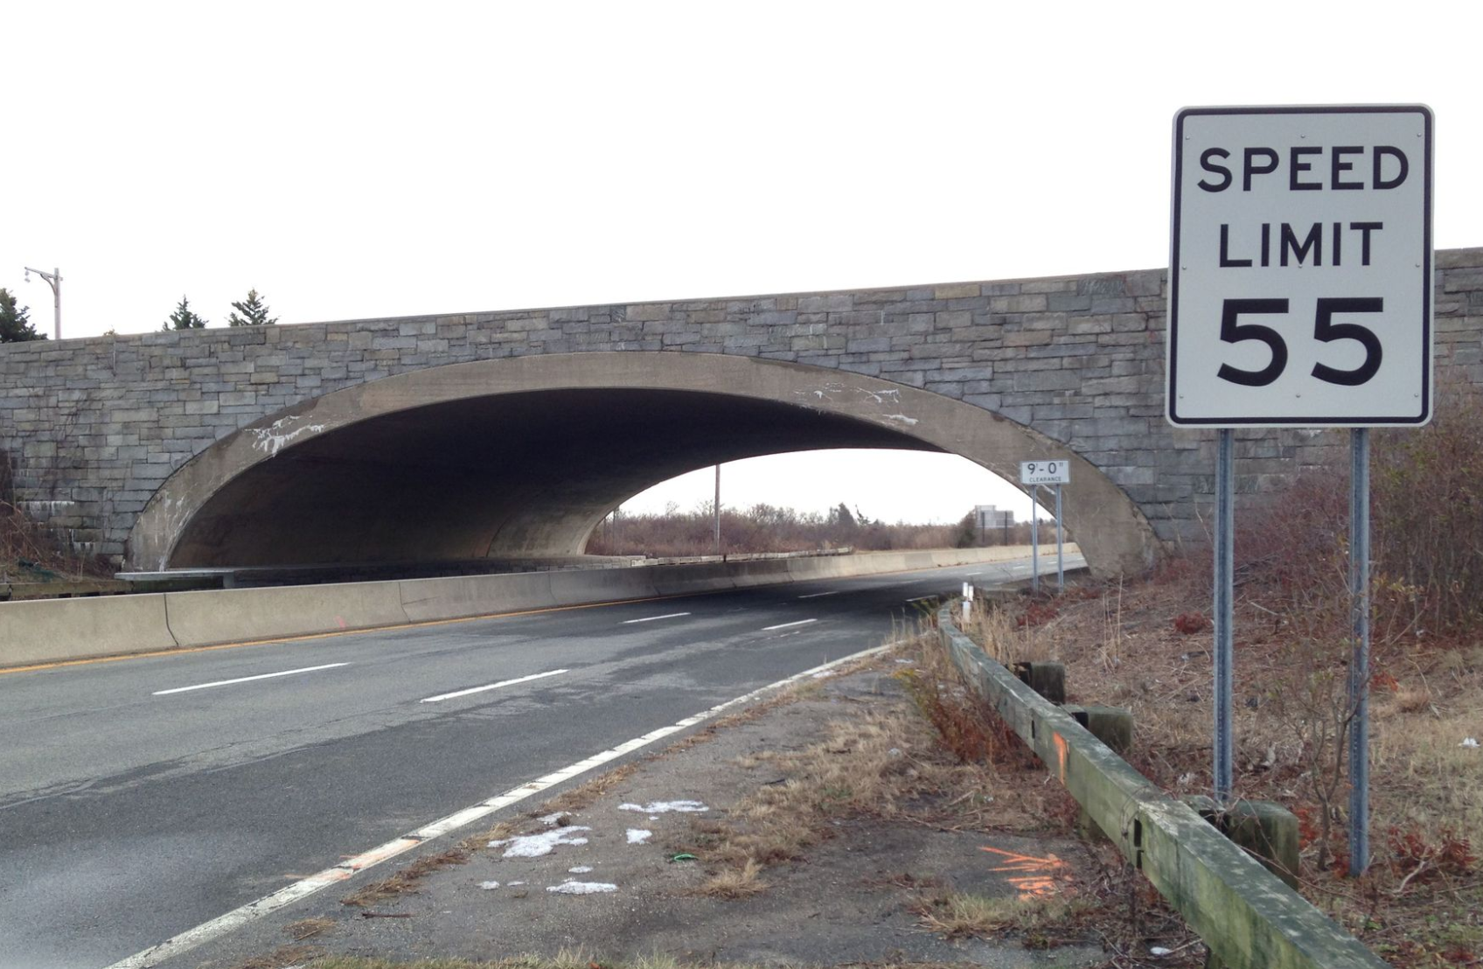
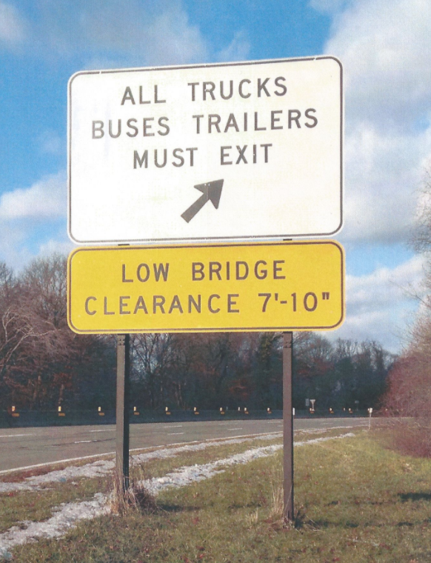
Langdon Winner, “Do Artefacts have Politics?”

Slide 12
Subjectivity
Algorithms are created by human programmers
They reflect subjective views on how textual phenomena ought to be identified an on how they can be analysed
Flanders and Jockers note that “tools bring the data into existence, not just into view”. Cf. Johanna Drucker: From Data to Capta. Or perhaps: Facta or Constructa?

Slide 13
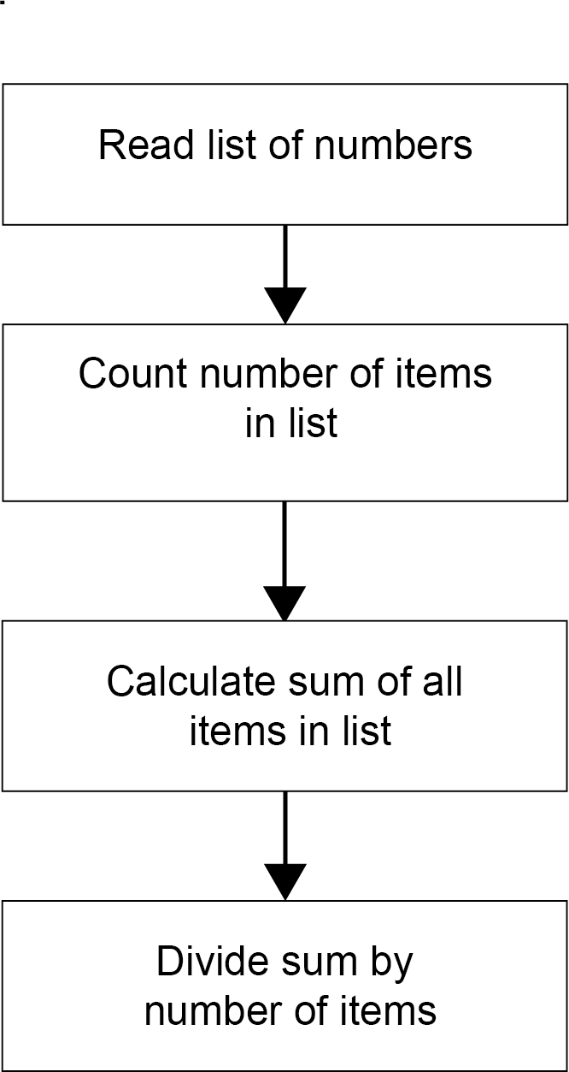
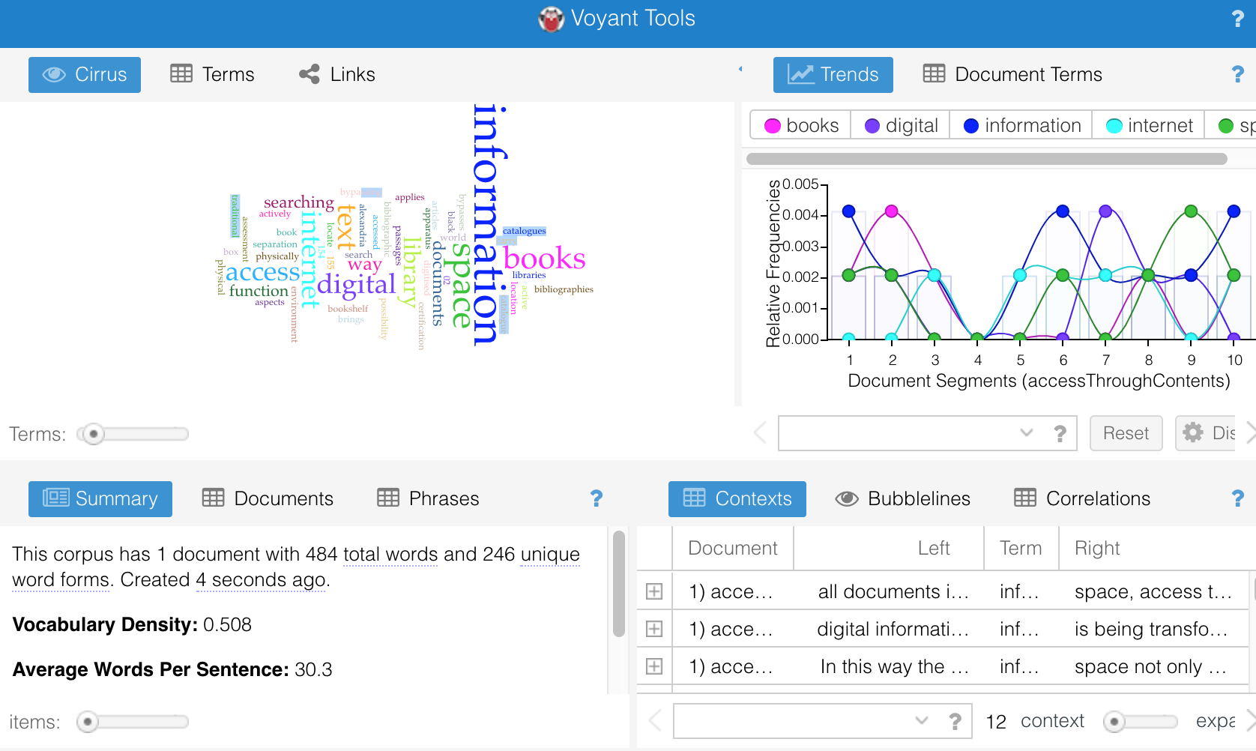
Opacity of algorithms
www.voyant-tools.org
Algorithm
Tools

Slide 14
Today’s Seminar
Exports from the Short Title Catalogue of the Netherlands
Books printed in the Netherlands or in Dutch before 1801.
Available as Linked Open Data
Ca. 80.000 records
Data encoded according to the MODS standard (Metadata Object Description Language)

Slide 15
MODS record
<mods>
<name type="personal"><namePart>Molière (1622-1673)</namePart>
</name>
<titleInfo><title>Le Sicilien, ou L'amour peintre, comedie. / By J.B.P. Moliere</title></titleInfo>
<language><languageTerm>fre</languageTerm></language>
<originInfo>
<dateIssued>1674</dateIssued><publisher> Elzevier, Daniel</publisher>
</originInfo>
<physicalDescription><extent>duodecimo</extent></physicalDescription>
<subject><topic>Drama</topic><topic>Poetry</topic><topic>French language and literature</topic></subject>
</mods>

